Slide 1
Lecture 8
Dynamic programming
Introduction
DP (memoization) factorial
DP (bottom-up) Fibonacci numbers
Computing a binomial coefficient by DP
String edit distance by DP

Slide 2
Dynamic Programming
Dynamic Programming is an algorithm design technique for optimization problems: often minimizing or maximizing.
Like divide and conquer, DP solves problems by combining solutions to sub-problems.
Unlike divide and conquer, sub-problems are not independent.
  Sub-problems may share sub-sub-problems,
  However, solution to one sub-problem may not affect the solutions to other sub-problems of the same problem.
DP reduces computation by
  Solving sub-problems in a bottom-up fashion.
  Storing solution to a sub-problem the first time it is solved.
  Looking up the solution when sub-problem is encountered again.

Slide 3
Steps in Dynamic Programming
Characterize structure of an optimal solution.
Define value of optimal solution recursively.
Compute optimal solution values either top-down with caching or bottom-up in a table (memoization) .
Construct an optimal solution from computed values.

Slide 4
Brute-force factorial
function factorial (n) {
if n is 0 then
return 1 //[0! = 1]
else
return n * factorial (n - 1)
}
e.g. calculate the factorial for each numbers
7 | 8 | 9 | 6 | 7 | …
Time and space Complexity O(n²)

Slide 5
DP (memoization) factorial
function factorial (n){
if n is in lookup-table then
return lookup-table-value-for-n
else if n is 0 then
return 1
else
x = n* factorial (n - 1)
store x in lookup-table in the nth slot //remember the result later
return x
}
lookup-table
0 | … | 6 | 7 | 8 | 9
 |  | 720 | 5040 | 40320 | 362880
7 | 8 | 9 | 6 | 7 | …
Complexity= n+ 1+ 1 + 1 + 1= kn= Θ(n)

Slide 6
Brute-force Fibonacci numbers
Recall definition of Fibonacci numbers:
  F(n) = F(n-1) + F(n-2)
  F(0) = 0
  F(1) = 1
Computing the n^{th} Fibonacci number recursively (top-down):
F(n)
F(n-1) + F(n-2)
F(n-2) + F(n-3) F(n-3) + F(n-4)
...

Slide 7
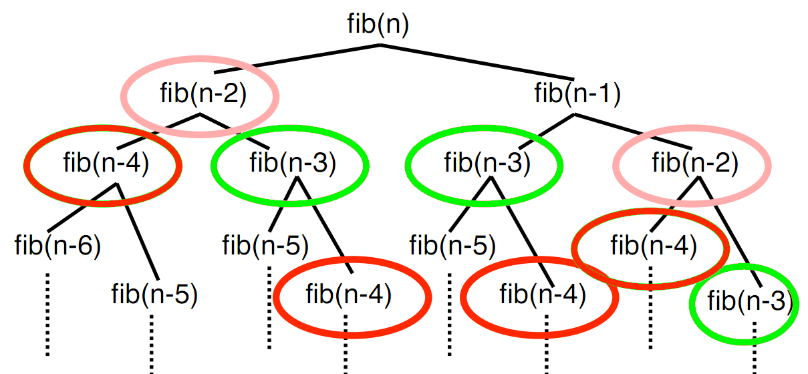
Brute-force Fibonacci numbers
function fib(n) {
if n = 0 return 0 else
if n = 1 return 1 else
return fib(n − 2) + fib(n − 1) } // time complexity = O(2^{n} )

Slide 8
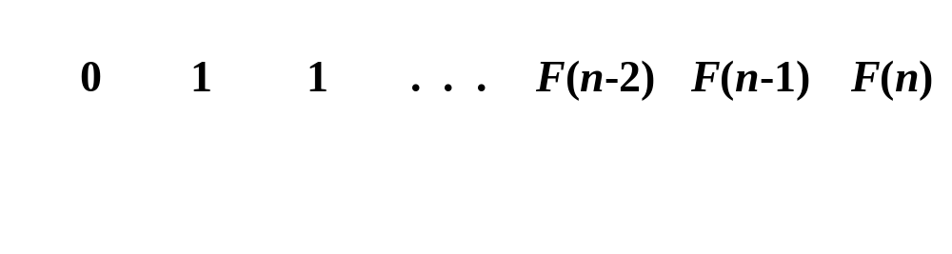
DP (bottom-up) Fibonacci numbers
  Computing the n^{th} Fibonacci number using bottom-up iteration and recording results (DP):
F(0) = 0
F(1) = 1
F(2) = 1+0 = 1
…
F(n-2) =
F(n-1) =
F(n) = F(n-1) + F(n-2)

Slide 9
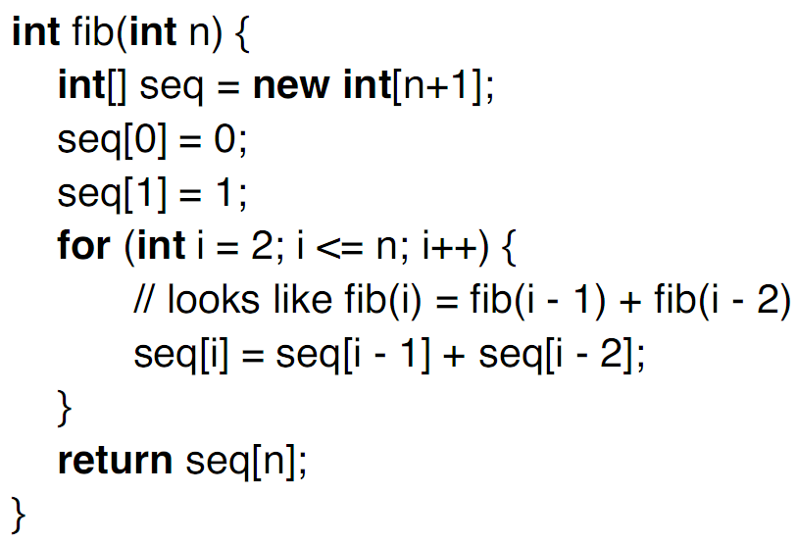
DP (bottom-up) Fibonacci algorithm
complexity:
- time = O(n)
- space = O(n)

Slide 10
Computing a binomial coefficient by DP
  Binomial coefficients are coefficients of the binomial formula:
  (a + b)^{n} = C(n,0)a^{n}b⁰ + . . . + C(n,k)a^{n-k}b^{k} + . . . + C(n,n)a⁰b^{n}
  Recurrence: C(n,k) = C(n-1,k) + C(n-1,k-1) for n > k > 0
  C(n,0) = 1, C(n,n) = 1 for n ≥ 0
  Value of C(n,k) can be computed by filling a table:
  0 1 2 . . . k-1 k
  0 1
  1 1 1
  2 1 2 1
  3 1 3 3 1
  4 1 4 6 4 1
  5 1 5 10 10 5 1
  6 1 6 15 20 15 6 1
  n-1 C(n-1,k-1) C(n-1,k)
  n C(n,k)

Slide 11
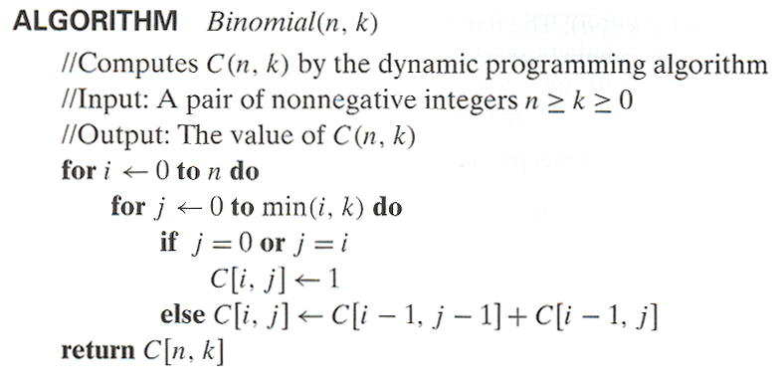
Computing C(n,k): and analysis
Time efficiency: O(nk)
Space efficiency: O(nk)

Slide 12
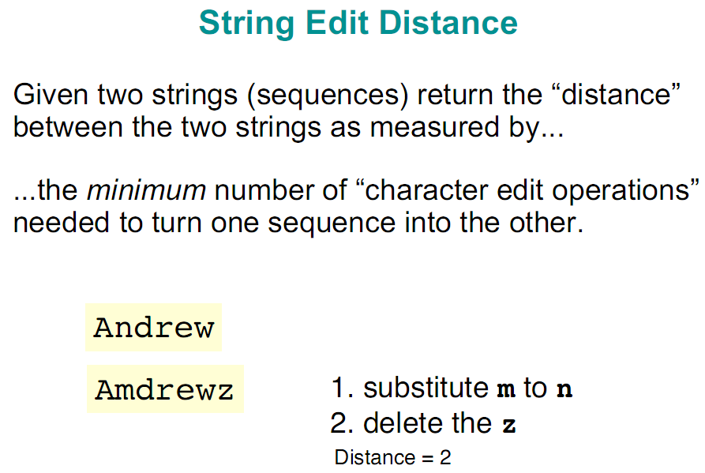

Slide 13
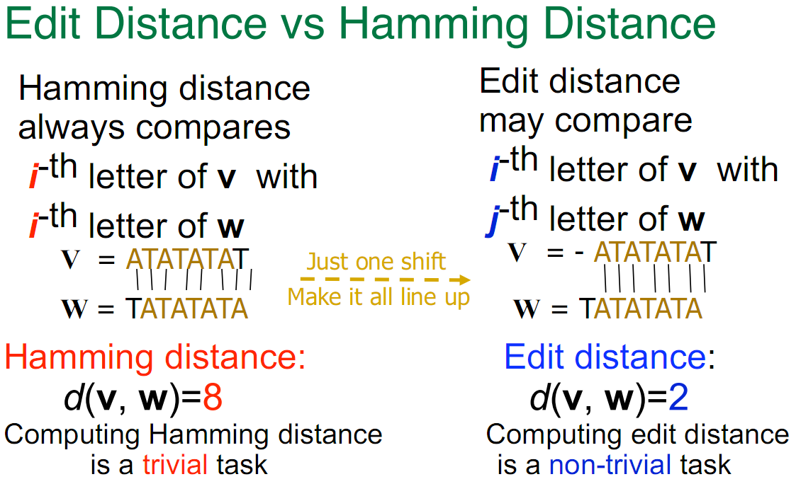

Slide 14
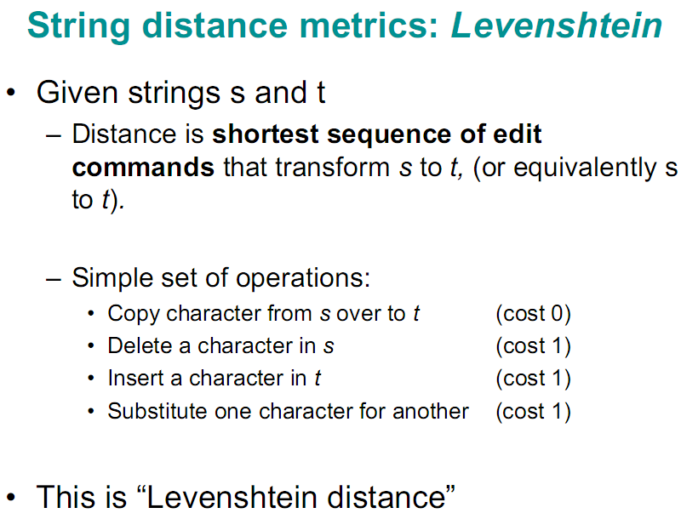

Slide 15
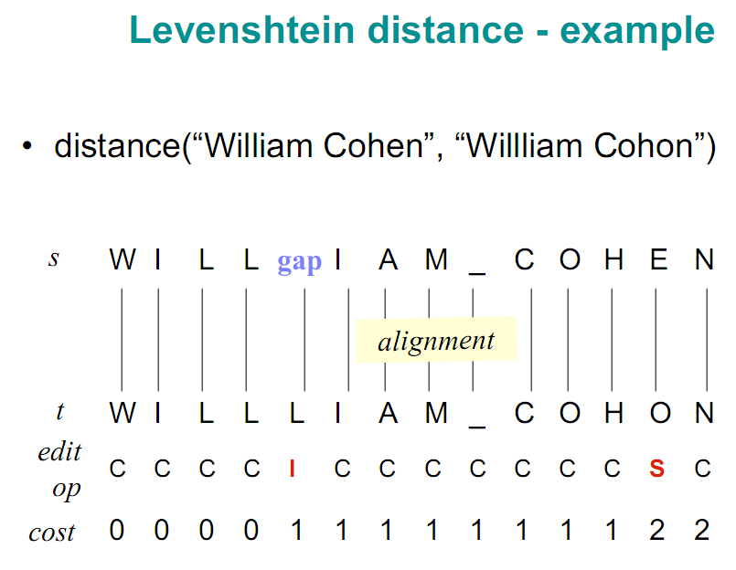
D

Slide 16
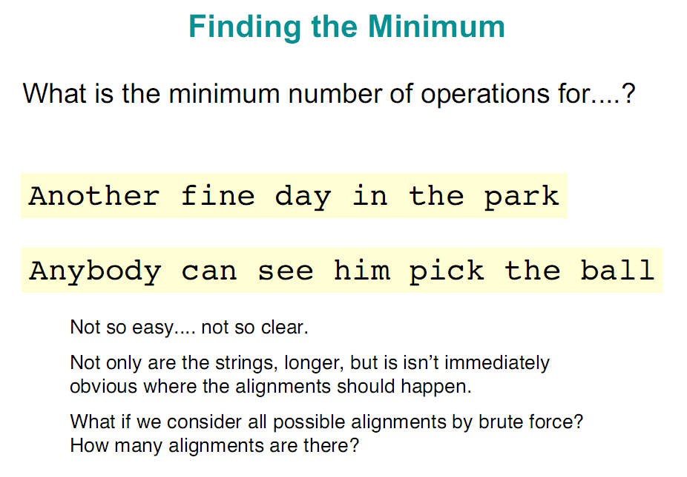

Slide 17
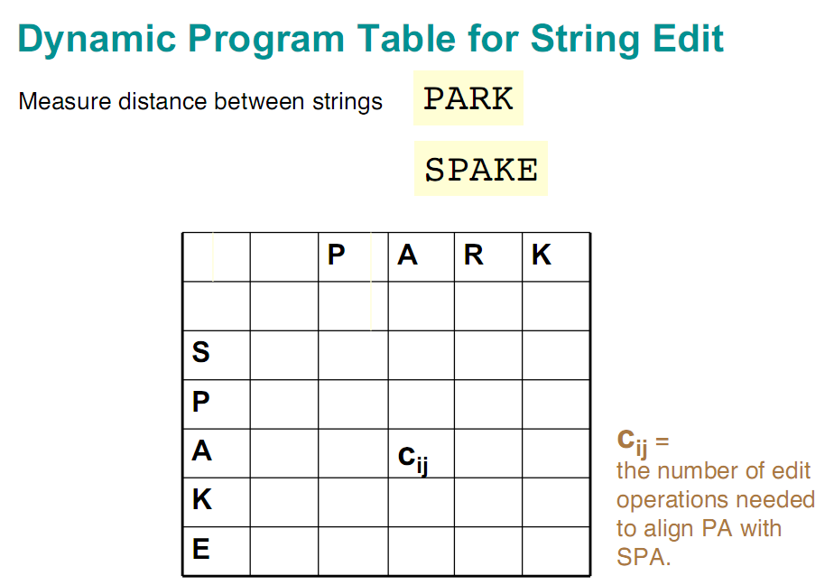
j
i

Slide 18
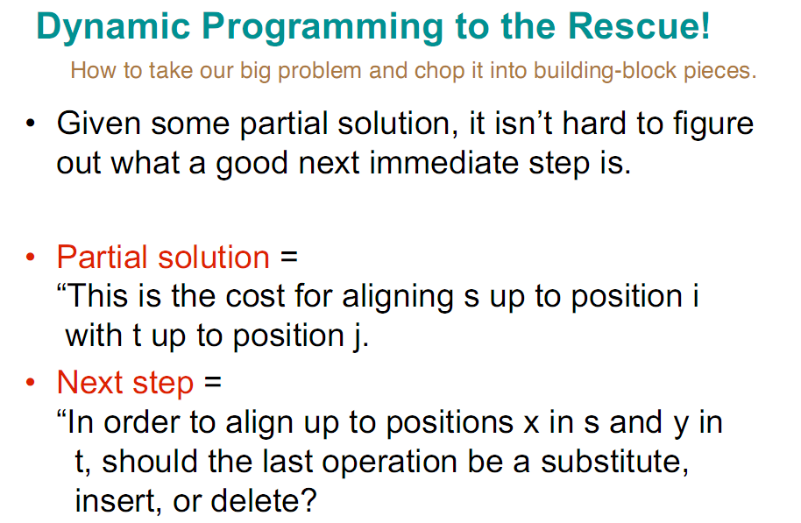

Slide 19
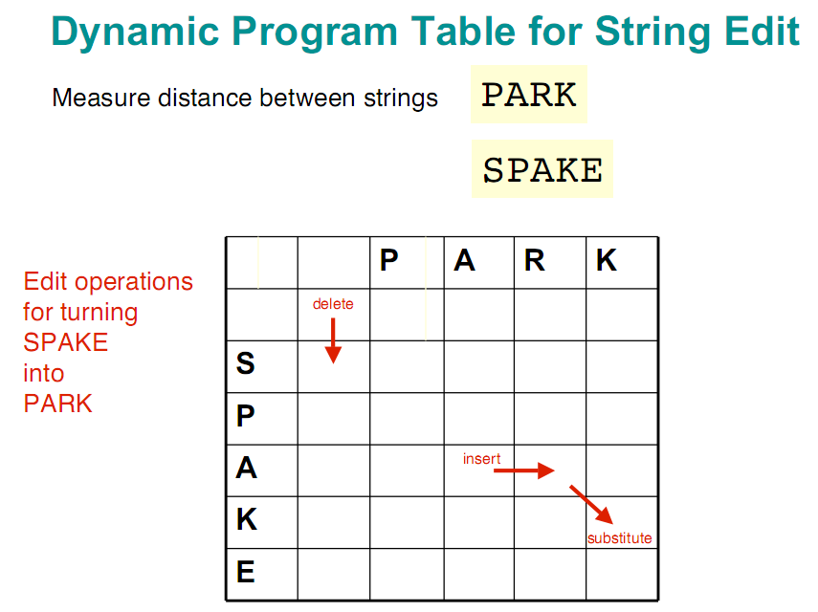

Slide 20
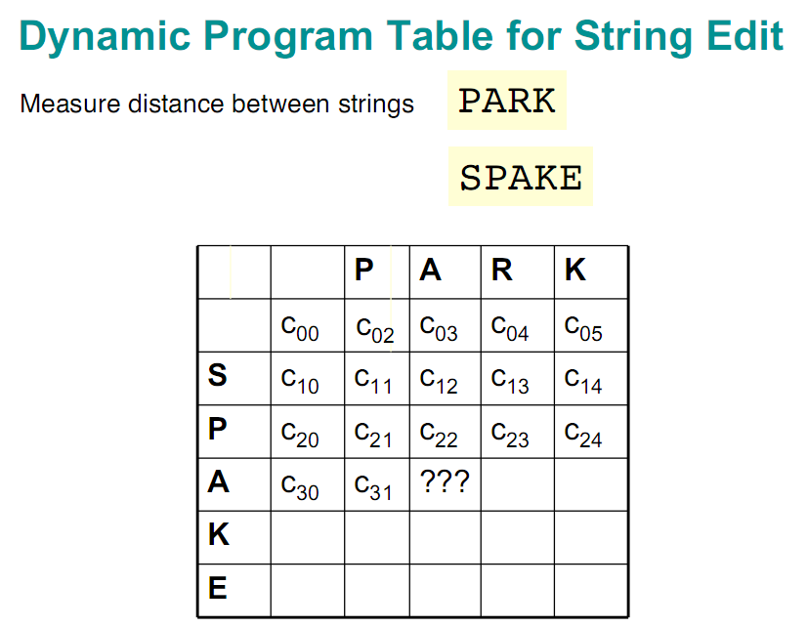

Slide 21
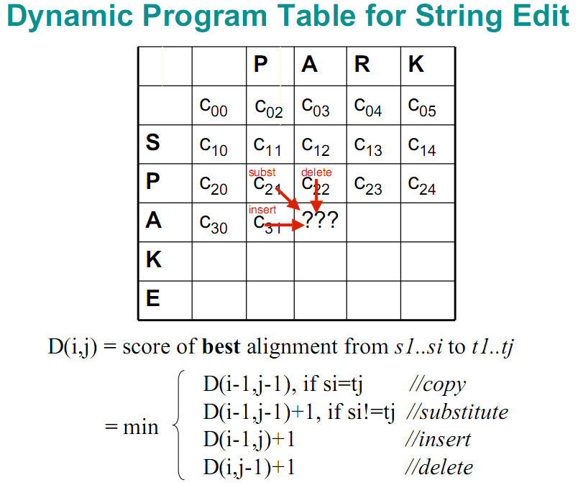
//delete
//insert

Slide 22
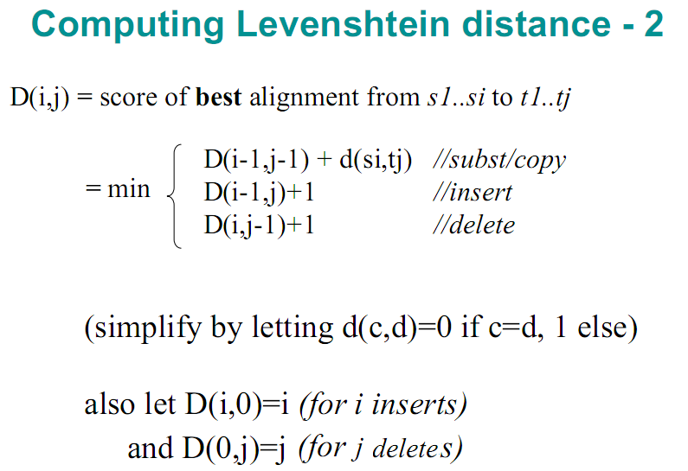
//delete
//insert

Slide 23
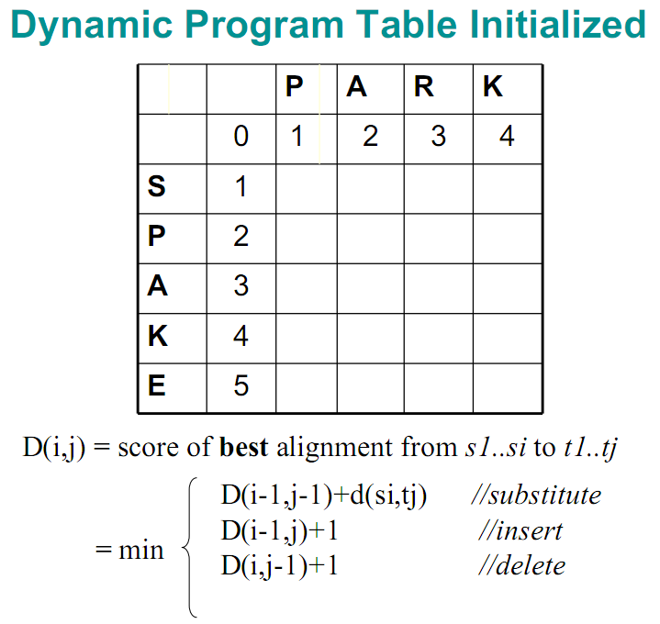
//delete
//insert

Slide 24
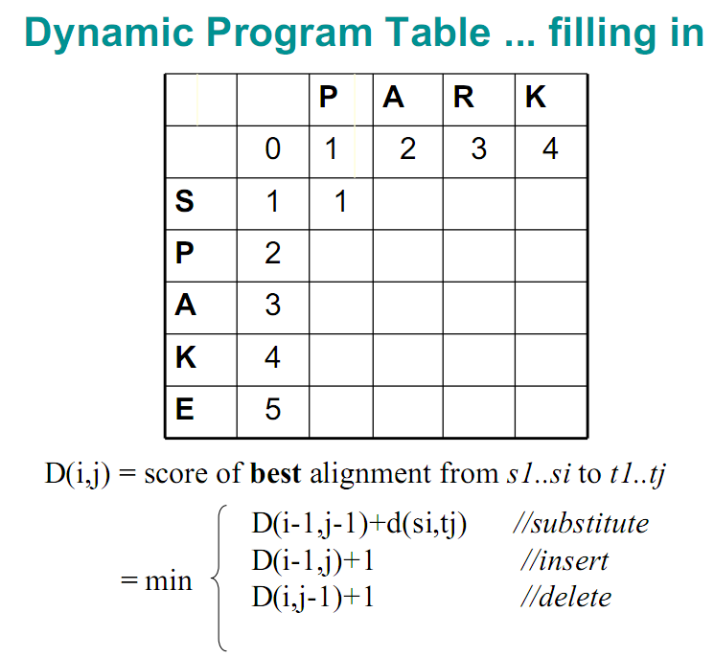
//delete
//insert

Slide 25
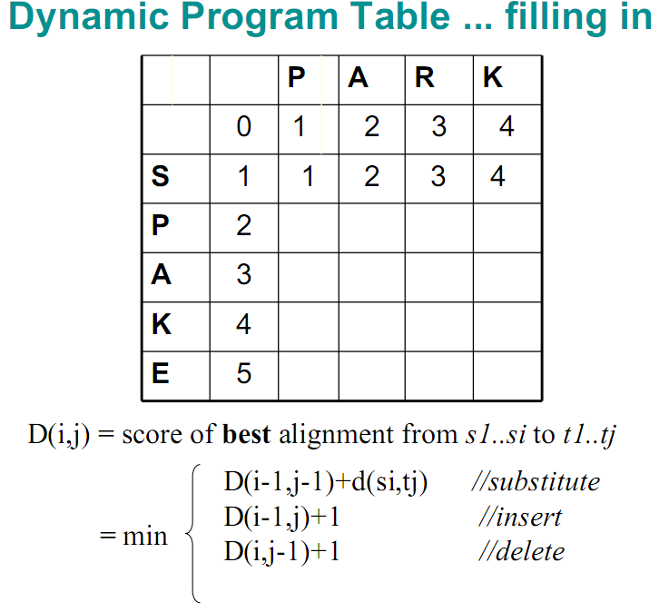
//delete
//insert

Slide 26
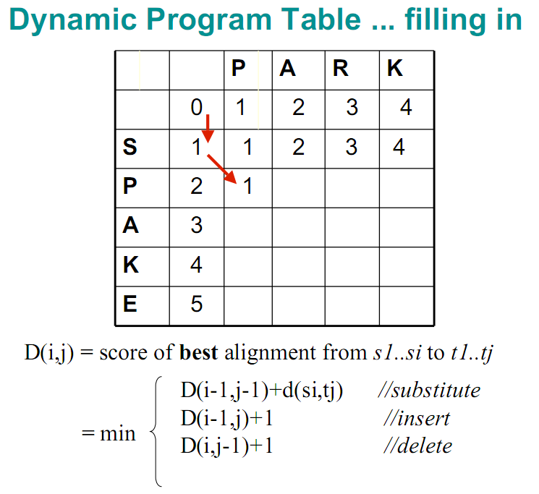
//delete
//insert

Slide 27
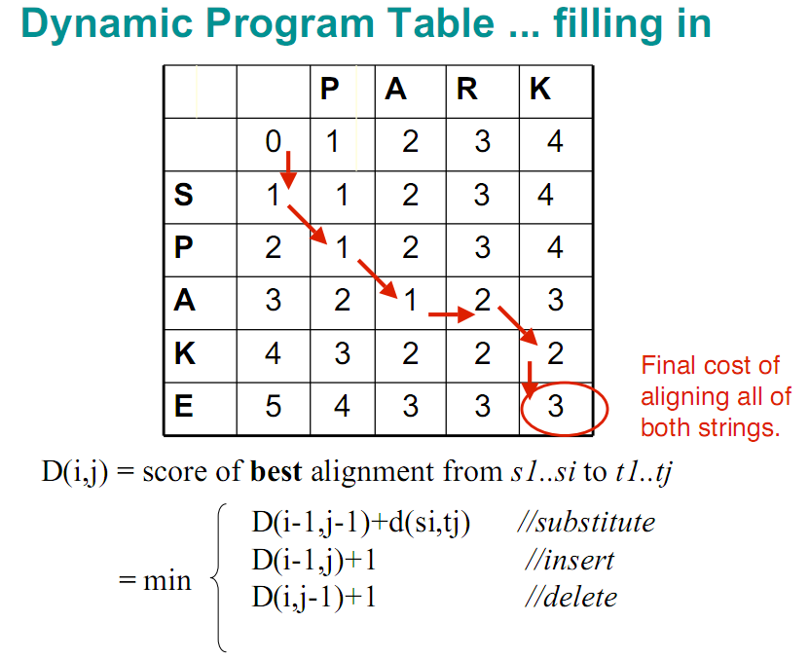
//delete
//insert

Slide 28
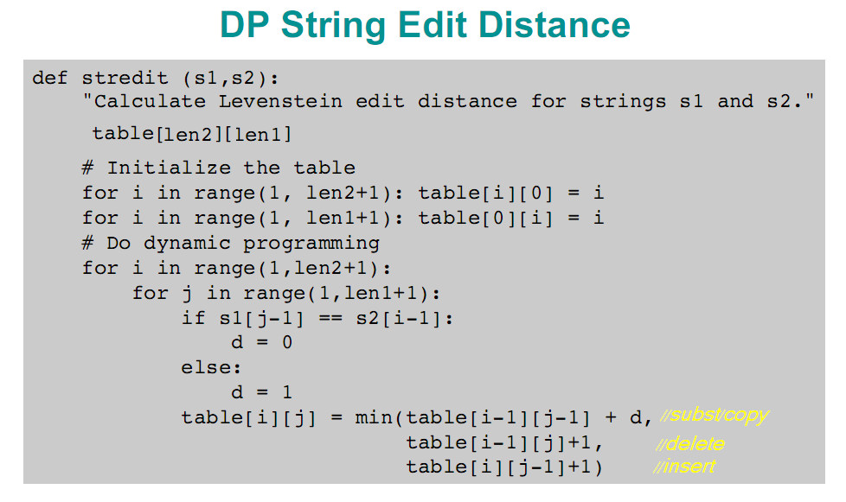
Time and space complexity = O(n²)

Slide 29
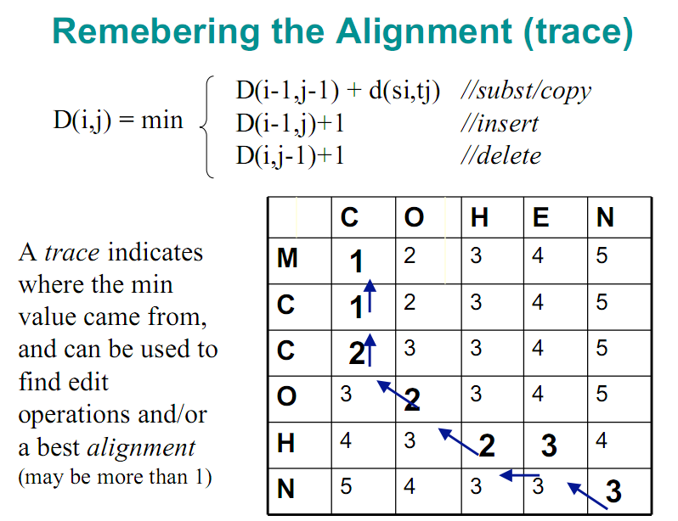
//delete
//insert

Slide 30
Home work
Write a c++ program to compare two strings using the Levenshtein distance.

